Slide 1
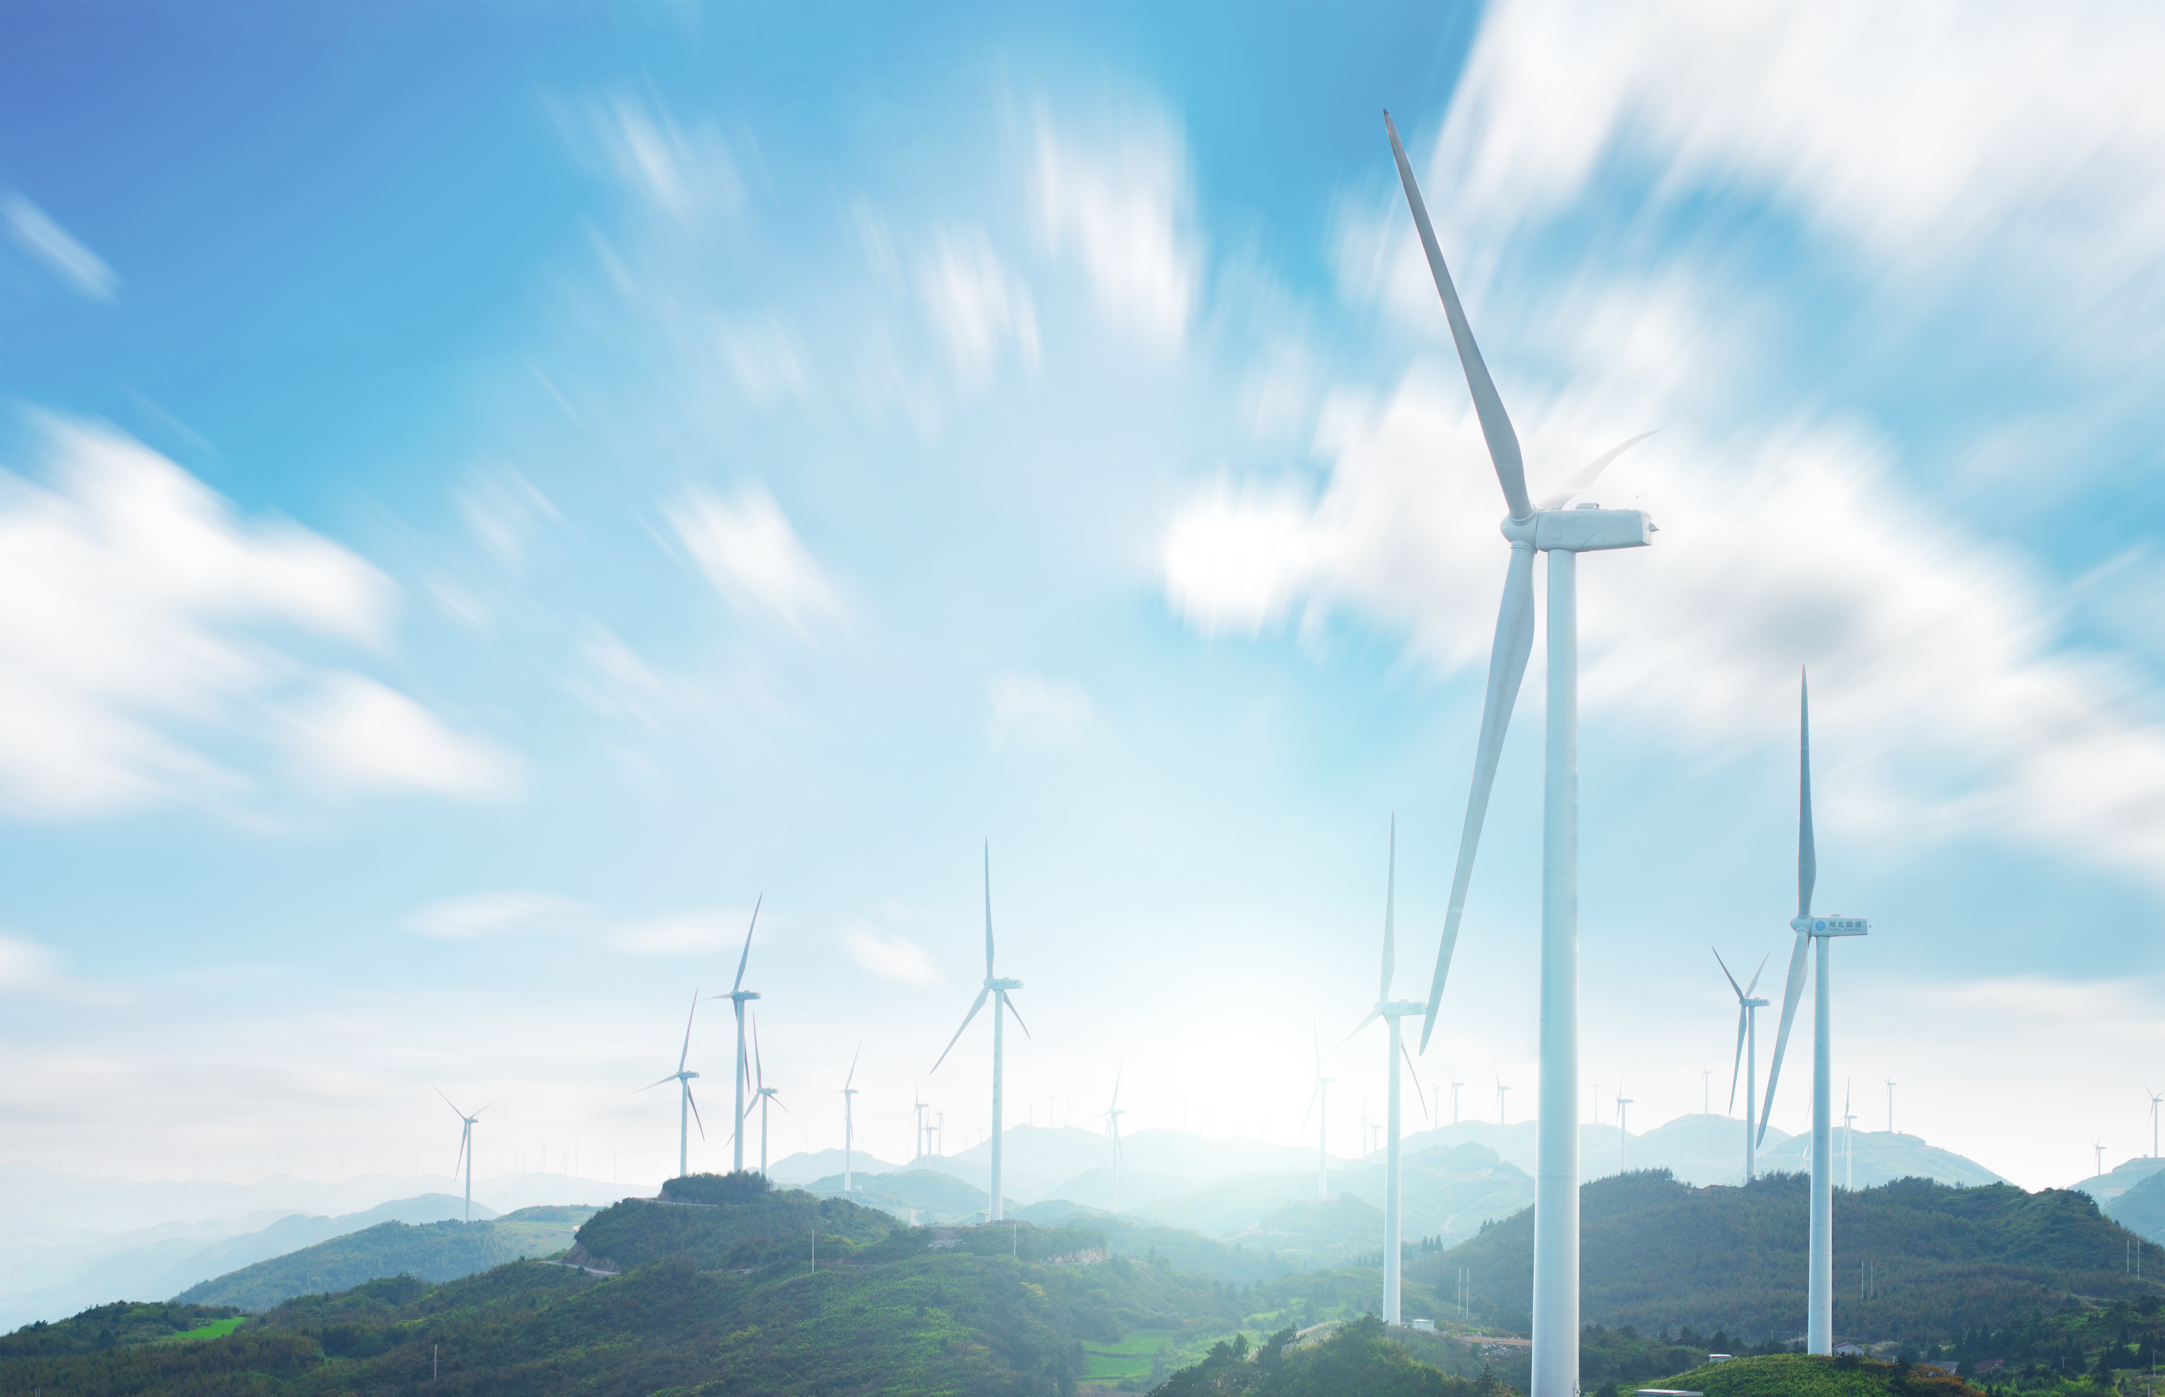


Technology as a Driver of Energy
Transformation
François Émond, Commissioner September 2026

Slide 2
Agenda
Where is Québec?
3 interconnected issues designed to deliver actionable regulatory and technical insights
  The invisible grid
  The Decentralization Risk: Cybersecurity of "Grid Edge" Technologies
  The Social Acceptability Bottleneck: Using Tech to Build Public Trust
Examples of innovations in Québec

Slide 3
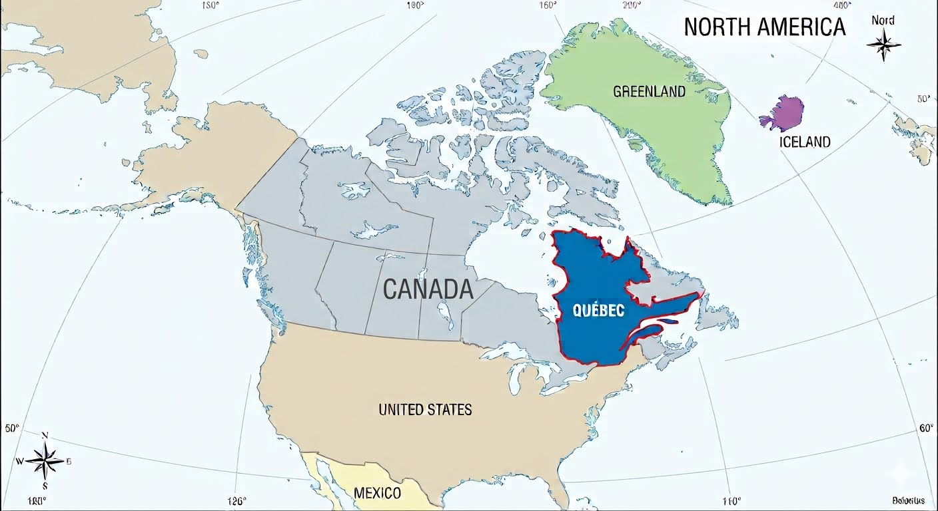
Where is Québec?

Slide 4
The invisible grid
  Deploying AI to Manage Peak Demand : Hardware alone cannot solve the energy transition; software and intelligent orchestration must take center stage.
  Building new generation assets and transmission lines takes a decade. To meet immediate electrification goals, regulators may consider technologies that optimize existing grids in real time.
  Energy transition may have an impact on demand growth (e.g. electric vehicles and switching from carbon heavy energy to cleaner energy), especially in jurisdictions that cannot build their way out of winter peaks. A solution to mitigate that impact could be a technology like a Virtual Power Plant (VPP), which uses AI to automate and shift residential energy loads.

Slide 5
The Decentralization Risk : Cybersecurity of “Grid Edge” Technologies
  As energy systems transition from centralized power plants to millions of interconnected, consumer-owned devices, the cyberattack surface expands exponentially.
  Smart meters, home batteries, and commercial EV fleets connect private internet-of-things networks directly to critical national infrastructure.
  Québec is an integrated market especially with import/export of energy; therefore, Quebec's energy security is tied to continental security. Protecting the grid means regulating the cybersecurity standards within the network.

Slide 6
The Social Acceptability Bottleneck : Using Tech to Build Public Trust
  Innovative technology fails if the public rejects the infrastructure required to deploy it.
  Energy transition may require the deployments of visible tech—such as smart meters, grid-scale battery storage, and high-voltage transmission lines. It’s not uncommon to see communities pushing back against these installations.
  To guarantee the success of these energy projects, an early economic and technological partnership with local and Indigenous communities is key. Proving the safety and local benefits of new technology is a key to secure social license.

Slide 7
Takeways
Artificial intelligence is no longer an innovation experiment; it is part of our environment.
Technological transformation will require global harmonization of cybersecurity standards for connected energy devices. We cannot decouple decarbonization from digital defense.
Technology cannot be forced onto a population. Regulators should evolve from evaluating purely financial metrics to creating frameworks that value community co-ownership and public transparency.

Slide 8

Questions ?

